Slide 1
Engage. Inspire. Prepare.
Annual Title I Parent Meeting
2023-2024 Panter Elementary
190 Panter School Road
Hiram, GA 30141 Media Center October 25, 5:30 PM
All parents/guardians of students attending Panter Elementary School have been invited to this meeting.
Notes:
Good morning and Welcome. Introduce yourself. Please sign in by typing your name in the chat box.

Slide 2
We welcome your questions and input throughout this presentation! We want to make sure you leave informed about the Title I program and know what opportunities we provide for families to be involved.

Slide 3
What Is a Title I School?
Title I was enacted in 1965 under the Elementary and Secondary Act amended by the Every Student Succeeds Act (ESSA). It is the largest Federal Assistance Program for our nation’s schools.
The purpose of Title I is to ensure that all children have a fair, equal, and significant opportunity to obtain a high-quality education and to achieve proficiency on high academic standards.​
Title I provides federal funds through the Georgia Department of Education to schools with at least 40% of the student population receiving free and reduced meals.

Slide 4
Title I funds at our school are applied to:
Supplementing programs that are already in place in schools, with the goal of providing all students with equal opportunity for achieving academic success
Hiring additional teachers and other support staff
Purchasing supplemental (additional) instructional materials, resources, and educational programs
Conducting parent activities and workshops focusing on how the school and families can work together to support students in content academic areas and other opportunities parents' request
Providing professional development for teachers and staff
Establishing a parent resource center
Outreach to local Pre-K schools

Slide 5
How Panter Participates in the Title I Program
Title I Support Staff
Parent and Family Engagement Meetings
Parent and Family Engagement Events/Nights
Parent Resource Center
Outreach to Local Preschools
Manage provided funds to meet student needs
Professional Development with Staff

Slide 6
Our Schoolwide Requirements
Identifying school needs and areas requiring academic focus for improvement by reviewing student achievement data
Setting goals for improvement, and making plans to incorporate strategies that are based on scientific research to increase student achievement
Identifying students who will benefit from additional support
Partnering with families in order to provide the best support possible for all students to make progress
Providing staff with training, professional learning, resources and materials in order to enhance their teaching, and ability to work effectively with families
Sharing of School Improvement Plan

Slide 7
Panter Schoolwide Program:
Our School Improvement Plan (schoolwide goals) include the following:
3rd-5th Grade students scoring proficient and advanced on the ELA Georgia Milestones will increase from 38% in Spring 2023 to 50% in Spring 2024.​
3rd-5th Grade students scoring proficient and advanced on the Math Georgia Milestones will increase from 51% in Spring 2023 to 55% in Spring 2024.​
The programs and supports in place to help us achieve these goals:
Professional Learning with Staff
Increased Resources Provided (human and material)
Increased Parent Engagement and Involvement
Panter Elementary State’s Grades Report

Slide 8
Curriculum Used at Panter
Academic standards are important because they provide an important first step in preparing our students for the future-a clear roadmap for learning for teachers, parents, and students. Having clearly defined goals helps families and teachers work together to ensure that students succeed. They also will help your child develop critical thinking skills that will prepare him or her for college and career.
Georgia Standards of Excellence (GSE)
Bookworms Reading- Shared Reading and Differentiated Instruction
Bookworms Writing- Interactive Reading and Writing Curriculum
Mathematics- Illustrative Math & Do the Math (Differentiated Instruction)
Social Studies and Science- GA Standards based on Grade Level curriculum

Slide 9
Tests and Assessments for Students in Elementary Grades Tests and assessments include those provided by the school (teachers), the county, and the state:
Panter - School wide: Acadience Benchmark, IDI (Informal Decoding Inventory), Do the Math Pre & Post Module Assessments (2nd-5th),
Classroom: Projects, Reports, Unit/Chapter Tests, Presentations, Illustrative Math Cool Downs & Checkpoints, Fact Fluency
County - Universal Math & Reading Screeners (Growth Measures), WriteScore: Informational, Narrative, Opinion
State - Georgia Milestones (3-5 grades), ACCESS (ELL students), GKIDS (Kindergarten)
Other assessments may apply. If applicable, our school will notify parents/guardians.

Slide 10
Tests and Assessments for Students in Elementary Grades
How do these assessments measure student progress?
Identifies areas in need of improvement, and to plan for instruction
Provides information for teachers and parents on areas where students have mastered learning and where they may need additional support
Provides information to plan for “next-steps” so that the student will experience continuous growth
What proficiency levels is my child expected to meet?
Teachers share specific information about student expectations/goals and assessment results during parent meetings, conferences and at the request of parents/guardians
Access previous test performance, standards, and attendance about your child using the Statewide Longitudinal Data System (SLDS) through the school’s parent portal (if applicable)

Slide 11
Georgia Milestones (Elementary)
Designed to measure how well students have learned the skills and knowledge described in the curriculum in the areas of English Language Arts and Mathematics in grades 3, 4, & 5
Science, grade 5
Taken at the end of the school year
Provides information on academic achievement at student, class, school, system, and state levels
Used to diagnose individual student strengths and weaknesses as related to the instruction of the state adopted curriculum, and to gauge the quality of education throughout Georgia.
Paulding County Milestones Calendar

Slide 12
2023-2024
Family Engagement Plans
PCSD Family Engagement Plan
Panter Family Engagement Plan
Panter Compact

Slide 13
Teacher Professional Qualifications
Parent’s Right-to-Know
All parents have the right to request the following information about the professional qualifications of your student’s teacher(s):
Whether the teacher has met the Georgia Professional Standards Commission’s requirements for certification for the grade level and subject areas in which the teacher provides instruction;
Whether the teacher is teaching under an emergency or other provisional status through which Georgia qualifications or certification criteria have been waived;
Whether the student is provided services by paraprofessionals, and if so, their qualifications.

Slide 14
Parent & Family Engagement Opportunities
Family Engagement Opportunities Family Night Events Visit Parent Resource Center All Pro Dads Parent/Teacher Conferences Parent Meetings about student data, understanding student progress and assessments, and more! Transition Meetings Parent Input Meetings/Surveys | Volunteer Opportunities PTA events Classroom/media center helper School events such as STEM Day, Book Fairs, etc Media Center Support | Parent Decision Making Opportunities Fall Parent Input during conferences Spring Parent Input Survey Title I Parent Surveys Local School Council

Slide 15
We love partnering with you!
We will promptly reply to your requests!
To contact to school staff: Kimberly Chastain, Panter Title I ILC kchastain@paulding.k12.ga.us or 770-443-4303 ext. 19005
To contact your child’s teacher directly, please use contact information on the weekly newsletter.

Slide 16
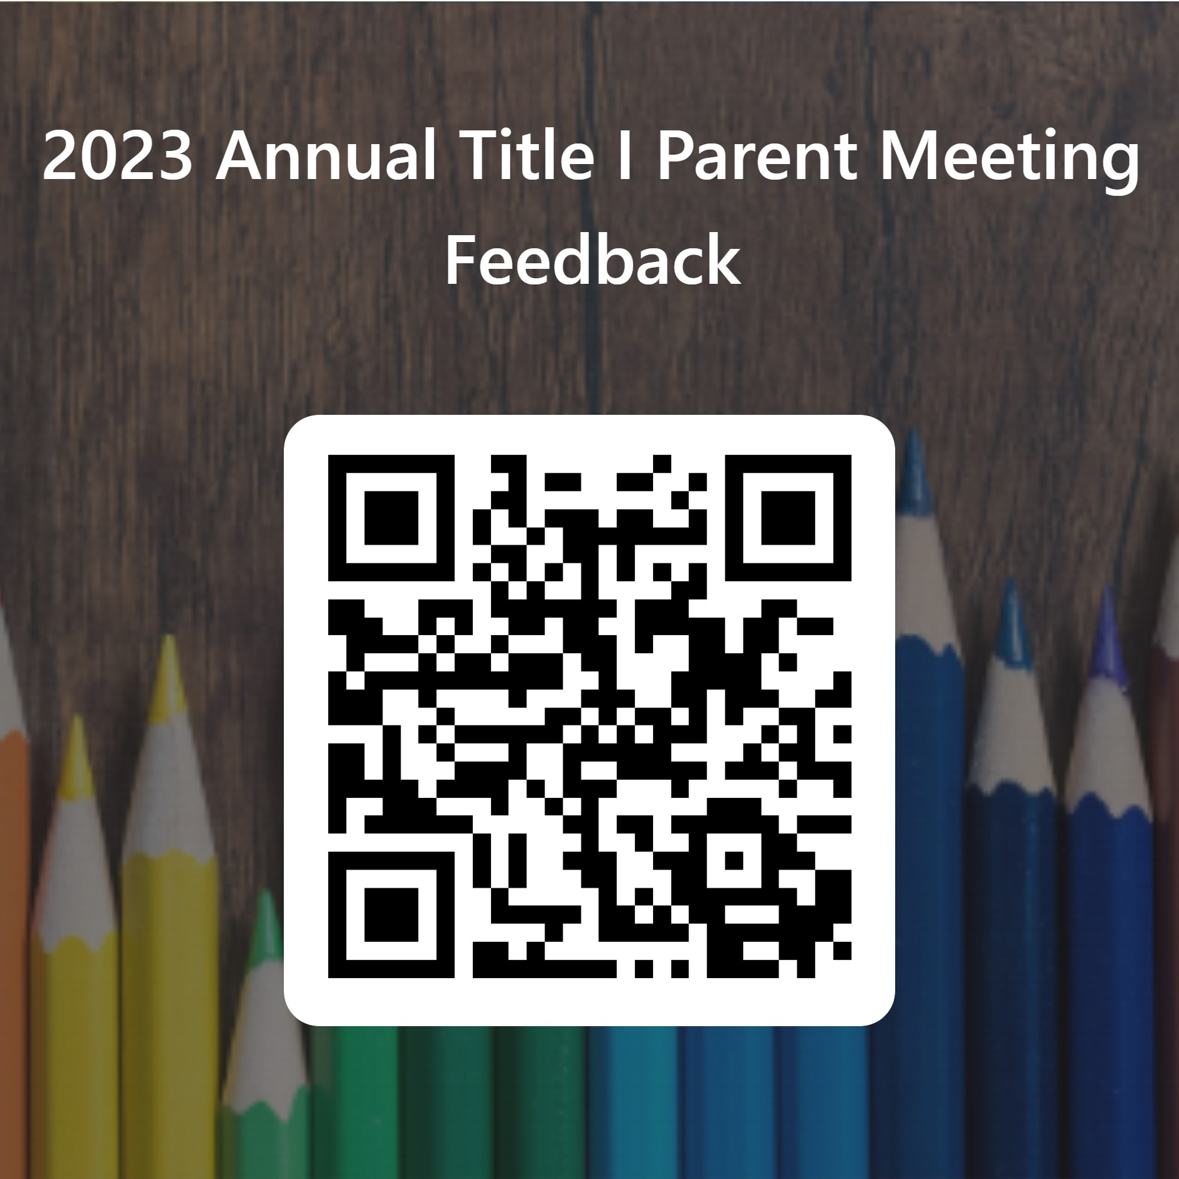
Thanks!
Closing and Feedback
https://forms.office.com/r/yCerYPrACz
Any questions?
Notes:
Post feedback link in chat box and post on Panter Website.

